Slide 1
Health Economics
Chapter 7: Health Capital

Slide 2
Grossman Theory of Health Capital
Health can be viewed as both a consumption and an investment good.
A consumption good is one that is purchased to satisfy the needs and wants of an individual (being healthier makes you feel better)
An investment good can be thought of one where costs are paid up front and gains are collected in the future. (Higher earnings for healthier, more productive workers).
We begin by modeling health as an investment good.

Slide 3
Conceptual Framework
Grossman (1972) “On the Concept of Health Capital and the Demand for Health”
Health care and time spent doing healthy activities can be thought of as inputs into the production of good health.
Better health means you have more “healthy days,” which are days that you can work and earn income.
Without health care and “healthy time,” health deteriorates, or depreciates.
→ Money spent on health care and the opportunity cost of healthy time can be thought of as investments that pay dividends in the future by way of increased earnings.

Slide 4
Example
A car:
provides a stream of services over time (travel) which can be used
to produce income (getting to work, or even doing work as a cabbie) or
utility (pleasure trips)
Regular maintenance is required to prevent against depreciation
Your level of investment in your car today depends on how much you discount the future.
The depreciation rate depends on how hard you drive the car

Slide 5
Car Example Continued
The optimal running condition (which determines performance/reliability) depends on :
the cost of a typical trip to the mechanic
the marginal value of another trip to the mechanic in terms of overall running condition
the rate of depreciation
The rate at which you discount the future.

Slide 6
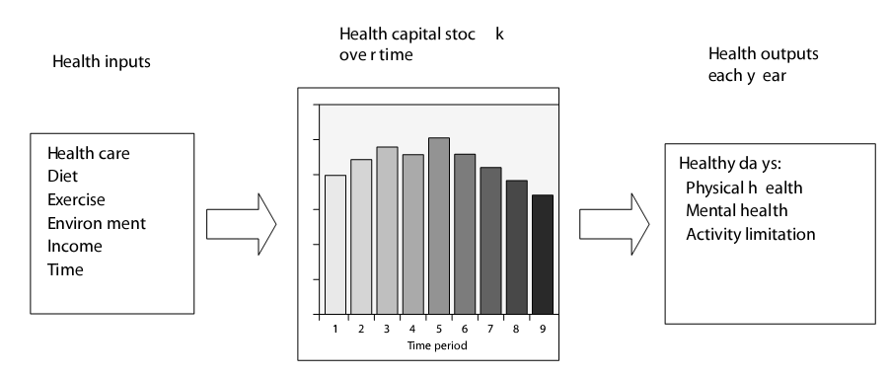
Health Capital Investment Theory
It is helpful to think of the demand for health as an investment in human capital.
Let’s think of investing in a capital good, i.e., a good that is used in the production of some output.

Slide 7
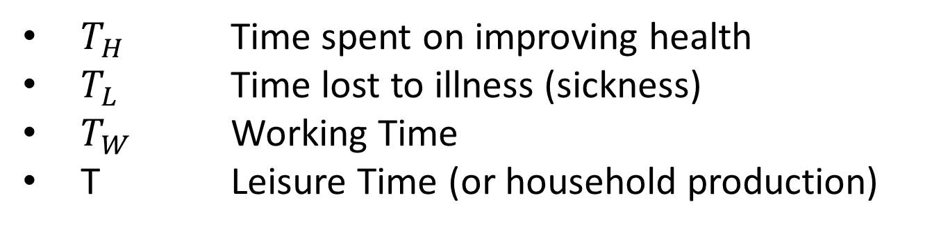
The Ultimate Resource Constraint
$T_{H}$ Time spent on improving health
$T_{L}$ Time lost to illness (sickness)
$T_{W}$ Working Time
T Leisure Time (or household production)

Slide 8
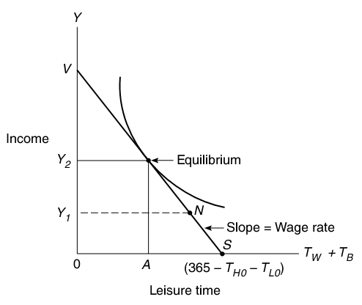
Labor-Leisure Trade-Off
= Leisure time
T
Leisure time
Work time

Slide 9
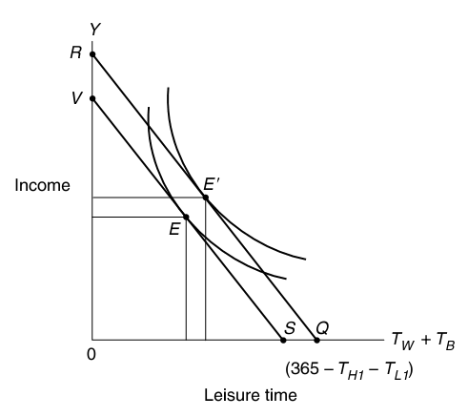
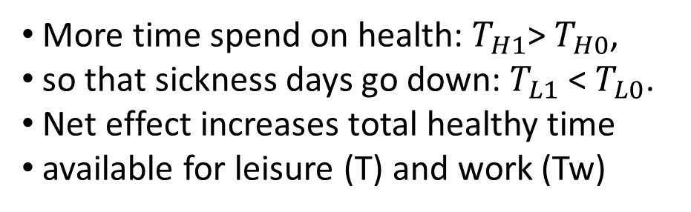
Investment in “Healthy Time”
More time spend on health: $T_{H1}$> $T_{H0}$,
so that sickness days go down: $T_{L1}$ < $T_{L0}$.
Net effect increases total healthy time
available for leisure (T) and work (Tw)
T
= Leisure time

Slide 10
Application to Health
Stock of Health Capital, or simply Health stock, can be thought of as your body’s “running condition”
Health stock produces some “# of healthy days” in a year, as in the picture below.
H_{min} - The minimum health stock required to stay alive
This production function exhibits diminishing returns to health stock.
Healthy days in a year
365
MP
Health stock
H_{min}
Health stock
H_{min}

Slide 11
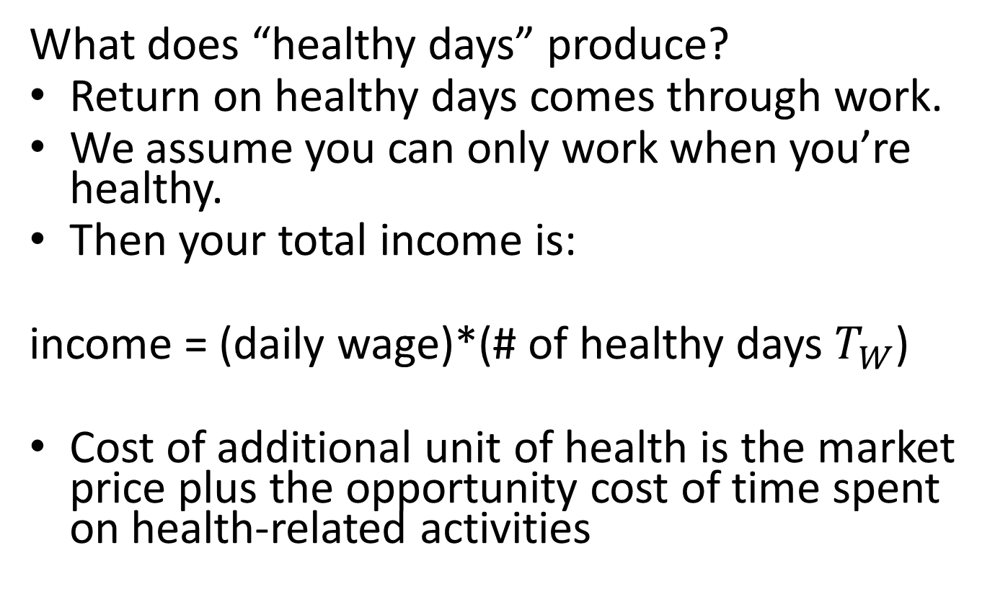
Marginal Efficiency of Capital
What does “healthy days” produce?
Return on healthy days comes through work.
We assume you can only work when you’re healthy.
Then your total income is:
income = (daily wage)*(# of healthy days $T_{W}$)
Cost of additional unit of health is the market price plus the opportunity cost of time spent on health-related activities

Slide 12
Marginal Efficiency of Capital
The marginal efficiency of capital (MEC) is the additional annual income over a lifetime per dollar spent on health stock today, assuming you maintain the new level of health stock.
It is a measure of the rate of return on investment.
MP of health stock (# of extra healthy days)
MEC
Health stock

Slide 13
Marginal Principle: When Do We Stop Investing?
To decide how much to invest in health stock, a person must think about two additional things:
What return he can get by spending that money on other things?
(i.e., the opportunity cost of capital) Say the market interest rate is r (more broadly, you can think of r as the rate at which you discount the future)
The fact that you will have to spend some of your additional income on maintaining your new health stock because of depreciation.
Let the depreciation rate (i.e., the amount of health stock you lose in a year if you do nothing) be δ.

Slide 14
Marginal Principle
Thus, you will invest in an additional unit of health stock if and only if its rate of return exceeds the interest rate plus the depreciation rate
MEC > r+ δ.
Rate of return on capital/investment
(MB of an additional dollar spent on health stock)
“time” cost of capital
(MC of an additional dollar spent on health stock)
This is equivalent to:
Additional annual income >= MC*r + MC*δ
Add’l annual income – MC*δ >= MC*r
Net add’l annual income
Opportunity cost of HC expenditure

Slide 15
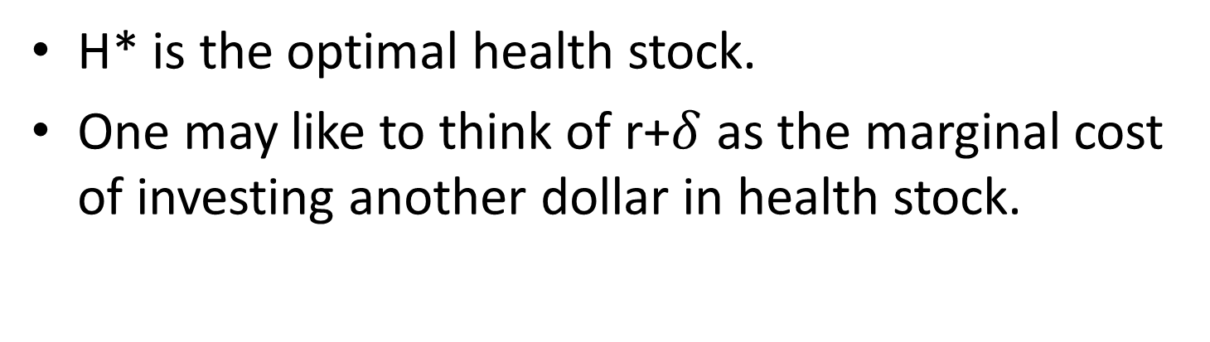
Optimal Health Stock
H* is the optimal health stock.
MEI
Health Stock
H_{Min}
H₁
H*
H₂
H* is the optimal health stock.
One may like to think of r+$δ$ as the marginal cost of investing another dollar in health stock.

Slide 16
Optimal Health Stock
MEC is the marginal benefit of investing in another unit of health stock.
In these terms, at H₁ marginal benefit exceeds marginal cost so it is beneficial to invest in more health stock.
But at H₂ the marginal cost exceeds the marginal benefit so the best thing to do is to let health stock depreciate.
You are indifferent between investing and not investing when health stock equals H*.

Slide 17
Comparative Statics using the Investment Model (ignores consumption value of health)
Comparative Statics: Examining how the change in an exogenous variable of a model influences the endogenous variables.
Endogenous: variables in a model whose value is determined inside the model (Health stock H, MC, MP)
Exogenous: variables whose values are determined outside the model (e.g. r, delta, wage, age, education, uncertainty)

Slide 18




Comparative Statics: Age
What factors affect the depreciation rate?
Age: $δ$_{y} < $δ$_{o} < $δ$_{d}
Still consistent with the observation that old people buy more medical care than young people: Getting old means that your stock depreciates fast so that the amount of health stock that you get for a given level of investment decreases
Model predicts that the optimal health level will decrease until death
Empirically corroborated prediction
r+ $δ$_{d}
r+ $δ$_{o}
r+ $δ$_{y}
MEC
H*₀
H_{min}
H*_{y}
Health stock

Slide 19
Factors Affecting MEC: Wage
Wage (higher wage implies higher gross rate of return of a health investment) and hence for
any given health stock an extra hour of work brings in more $ for a higher wage earner
Ceteris Paribus, higher wage individuals should have a higher health stock.
This outward shift is ambiguous, since the opportunity cost of time in producing health investments goes up, so marginal costs are a function of wages: MC(W).
So that return on health may go down.
MEC_{high wage}
MEC_{low wage}
H₀
H₁
Health stock

Slide 20
What Factors Affect MEC?
Counter-arguments:
The Wall-Street effect/lifestyle (Nope, it’s a ceteris paribus thing), lifestyle is not in the model.
The opportunity cost of health producing time is higher (OK, legit); so the result may be ambiguous because MC(W).
Odd prediction: Upon retirement, one should optimally choose to die!!
This is because we are ignoring the consumption aspect of health and the value the person puts on that.

Slide 21
Empirical Studies: What Factors Affect MEC?
Note: Grossman empirically found the opposite correlation between income level and health. Why might this be?
Answer: He failed to control for lifestyle…higher incomes may be associated with unhealthy lifestyles
He didn’t isolate the wage effect – he needed to keep hours worked constant
The model predicts a positive relation between health care spending and health capital, the data show a negative relationship.
Lags in health investments and health outcome could be the answer (see Galamata and Kapteyn (2009)).

Slide 22
Empirical Studies: What Factors Affect MEC?
Others have found an inverse relationship between health and upturns in the US business cycle!!!!
Same effect for developing countries?

Slide 23
Are Bad Times Healthy?
Based on NY-Times article from 10/07/08
Long-term economic gains lead to improvements in a population’s overall health (both in industrialized and developing countries), BUT …
People tend not to take care of themselves in boom times
drinking too much (especially before driving),
dining on fat-laden restaurant meals,
skipping exercise, doctors’ appointments, time with their children because of work-related time commitments
people experience more stress in boom times?
Similar patterns have been seen in some developing nations (e.g. high coffee prices correlated with bad health)

Slide 24
“Are Recessions Good For Your Health?”
Christopher Ruhm, The Quarterly Journal of Economics, 2000, vol. 115, issue 2, pages 617-650
Total mortality and eight of the ten sources of exhibit procyclical fluctuation (suicide is the only exception)
The variations are largest for those causes and age groups where behavioral responses are most plausible
Some evidence that the unfavorable health effects of temporary upturns are partially or fully offset if the economic growth is long-lasting
Smoking and obesity increase when the economy strengthens
Physical activity is reduced and diet becomes less healthy

Slide 25
Are Bad Times Healthy? (2)
Japan in the 1990s
Unemployed were twice as likely to be in poor health than those with secure jobs
Peru’s economic crisis 1980s:
Infant mortality increased 2.5 percentage points
Individuals born in a recession were at higher risk for heart problems later in life and lived, on average, 15 months less than those born under better conditions
Poor economic conditions can also cause stress that may interfere with parent bonding and childhood development

Slide 26
Are Bad Times Good for your Health? Conclusion?
YES: This scenario may be relevant for well-to-do families where one of the parents loses a job and the other still brings in enough money
NO: But in a crisis where the family may have to incur huge housing-cost losses and the household income is insufficient for adequate nutrition and health care, the adverse effects of being born in a recession seem much more relevant
United States, which unlike other industrialized nations lacks a national health plan, the recession may take a greater toll
46 million Americans lack health insurance and even among the 179 million who have it, an estimated 1 in 7 would be bankrupted by a single health crisis
New York Times, October 07, 2008.

Slide 27
Education Affects MEC
Grossman assumes more educated people can more efficiently combine health capital inputs to produce health status, a better know-how of using inputs (i.e., MP is higher at any given level of health stock)
Ceteris paribus, more educated individuals should have a higher health stock
This is a “supply side” explanation for the positive correlation between health and education
Can anyone come up with a demand side explanation?
Returns can be generated at lower cost, so that rate of return becomes higher
MEC_{high wage}
MEC_{low wage}
H₀
H₁
Health stock

Slide 28
Other Impacts of Education
Demand Side Explanation:
More educated people may enjoy healthy food more
They know more about dangers of smoking, etc.
Decrease depreciation rate
Rate of time preference (spurious correlation)
Effects of education are strong, especially mother’s education
A study of the impact of sanitary systems and better sources of water in Bangladesh and Indonesia revealed that neither appeared to significantly affect child survival rates, but parent’s wealth and education were very important

Slide 29
Other Factors Empirically Correlated with Health
Positive
Being married, especially among men (psoriasis goes down as does alcoholism);
Increased leisure time (Elasticity between 0.25-0.65)
Negative
Age
Urbanization
Being overweight
On a final note, be aware that the model does not incorporate the fact that disease hits at random times (uncertainty) and that uncertainty might have an impact on optimal health levels

